Slide 1

Virtual Drum Kit
By Chee Wei Xian (U2021644K)
Notes:
Hi everyone. My name is weixian.
I present to you my tinyML project, which I name it “Virtual Drum Kit”
As the name suggests, it is a drum playing tool - but it is not physical drumset.

Slide 2
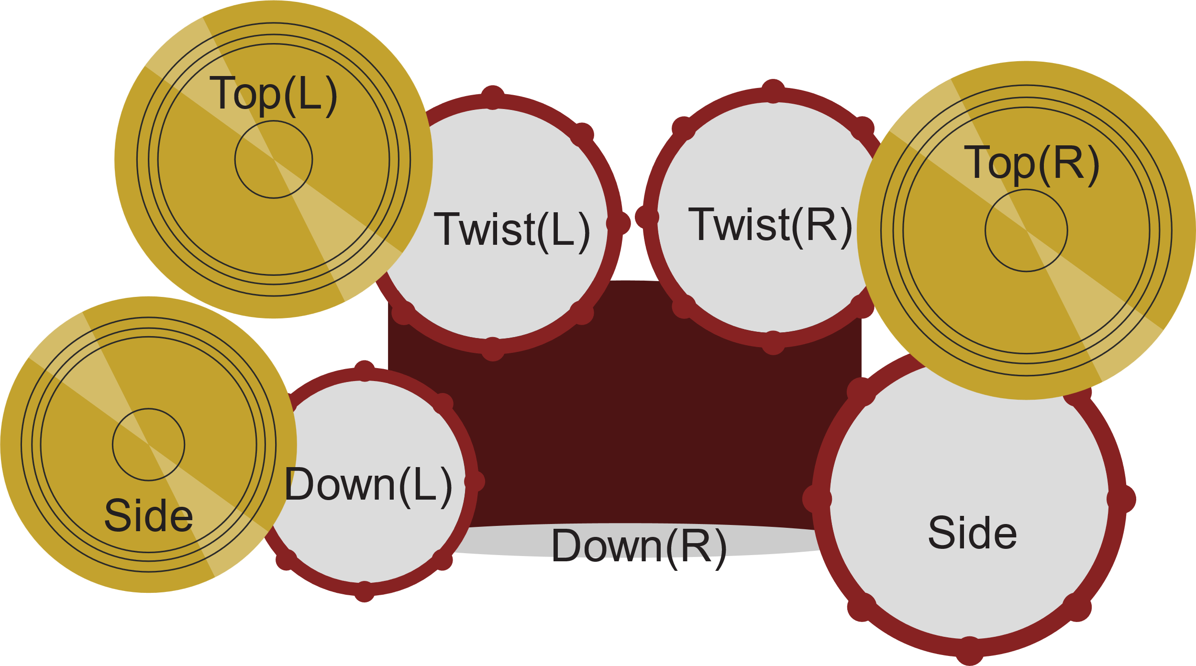
Notes:
Instead, I choose different type of gestures with each triggers a unique drum sounds. With all gestures together complete the virtual drum set.

Slide 3
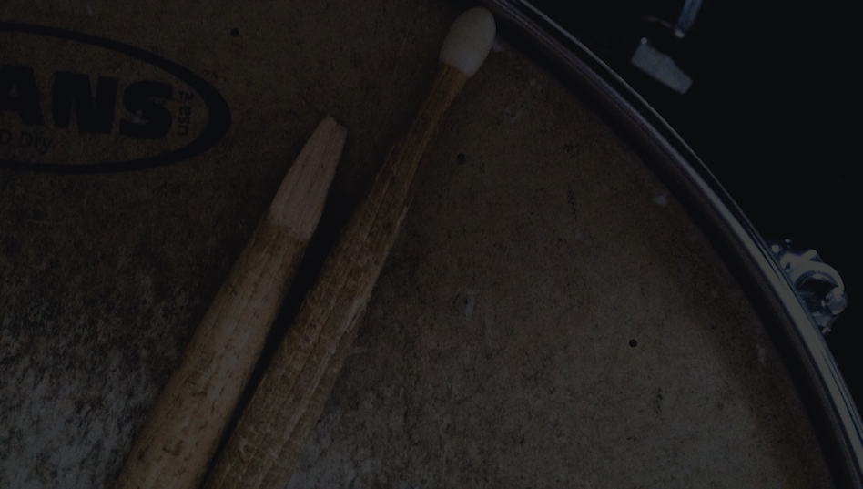

Outlines
Hardware & Software used
Data Collection & Model Training
Design Goal
Inference accuracy vs inference speed
Result
Demo

Slide 4
Hardware
2x Arduino Nano 33 BLE or Arduino Nano 33 BLE Sense board
4x rechargeable 18650 batteries
2x 18650 battery holders
A laptop

Slide 5
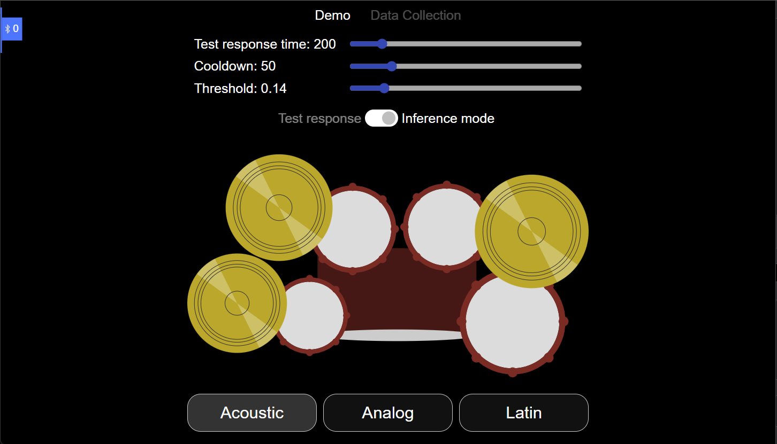
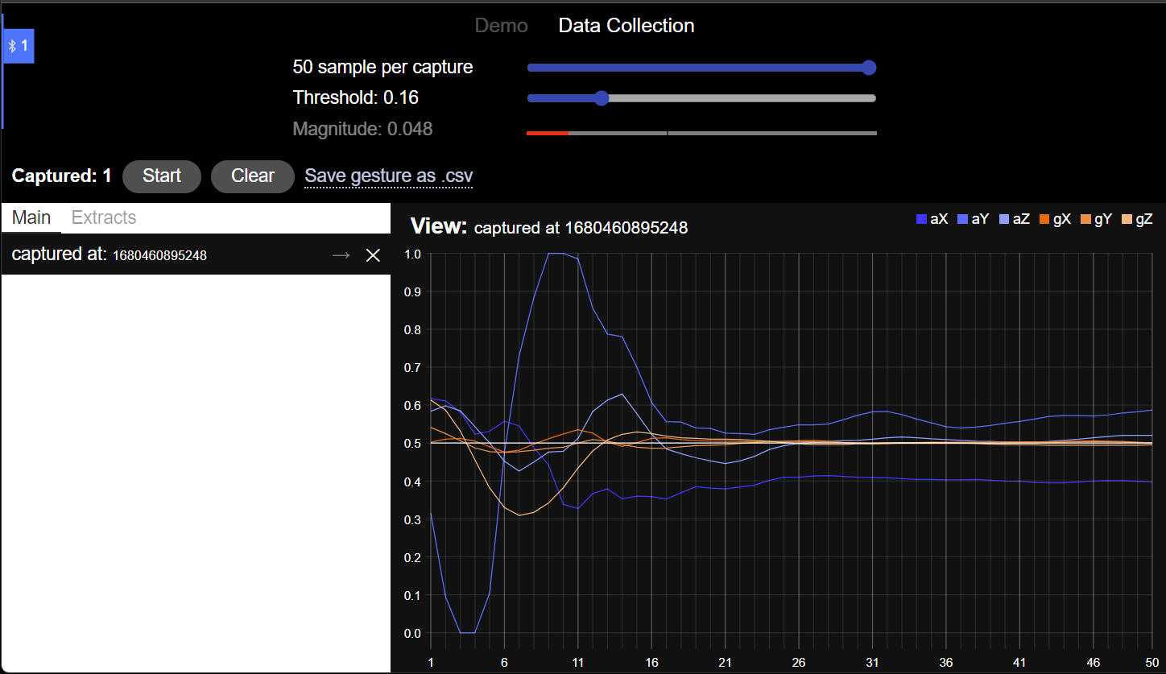
Software
A web application designed to play drum sounds and perform data collection
An executable run on Arduino to send/receive signal from the web app

Slide 6
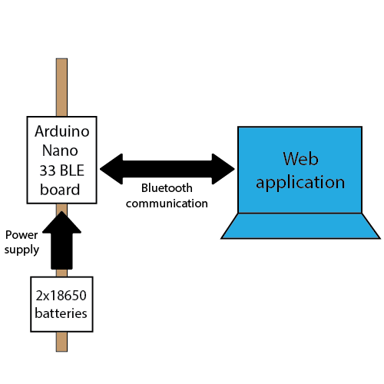
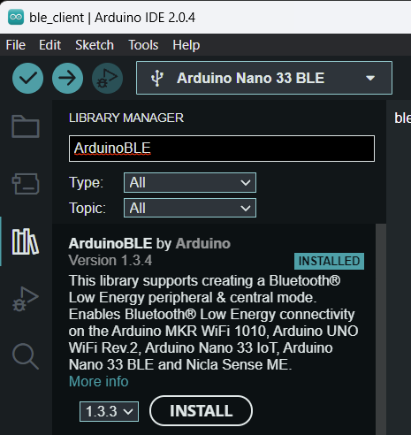
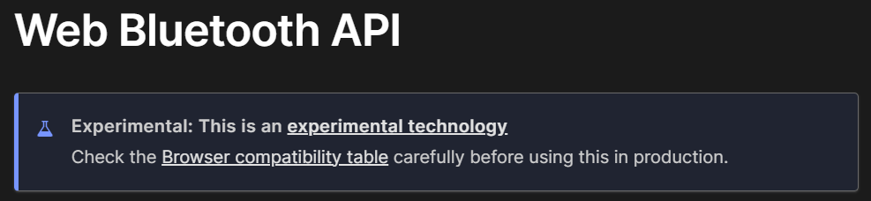
Notes:
Here is a simple block diagram that describe how different components communicate with each other
We have the Arduino board powered by two rechargeable batteries
The Arduino board and the web app communicate using Bluetooth.
On the Arduino board we use ArduinoBLE library to allow the board advertise its presense to the web app
On the web app, we gain access to the Bluetooth feature using Web Bluetooth API.
Once the communication is established, we are ready to perform data collection as well as sending inference result from the board to the web app.

Slide 7
Data Collection
xxx
xxx

Slide 8
Model Training
xxx
xxx

Slide 9
Design Goal
High accuracy in inference
Low latency in response to user gesture

Slide 10
Design Goal – high accuracy
Data collected must be robust
High accuracy in inference

Slide 11
Design Goal – low latency
Define a suitable threshold to trigger data sampling
Minimise response time

Slide 12
Notes:
The design goal - solidify tasks I want to achieve in order to make a highly responsive gesture based application

